Slide 1
COMP 122/L Lecture 6
Mahdi Ebrahimi Slides adapted from Dr. Kyle Dewey

Slide 2
Assembly

Slide 3
What’s in a Processor?

Slide 4
Simple Language
We have variables, integers, addition, and assignment
Restrictions:
Can only assign integers directly to variables
Can only add variables, always two at a time
Translation
x = 5;
y = 7;
z = x + y;
Want to say:
z = 5 + 7;

Slide 5
Implementation
What do we need to implement this?
x | = | 5;
y | = | 7;
z | = | x | + | y;

Slide 6
Core Components
Some place to hold the statements as we operate on them
Some place to hold which statement is next
Some place to hold variables
Some way to add numbers

Slide 7
Back to Processors
Amazingly, these are all the core components of a processor
Why is this significant?

Slide 8
Back to Processors
Amazingly, these are all the core components of a processor
Why is this significant?
Processors just reads a series of statements (instructions) forever. No magic.

Slide 9
Core Components
Some place to hold the statements as we operate on them
Some place to hold which statement is next
Some place to hold variables
Some way to add numbers

Slide 10
Core Components
Some place to hold the statements as we operate on them - memory
Some place to hold which statement is next -
program counter
Some place to hold variables - registers
Behave just like variables with fixed names
Some way to add numbers – arithmetic logic unit (ALU)
Some place to hold which statement is currently being executed – instruction register (IR)

Slide 11
Basic Interaction
Copy instruction from memory at wherever the program counter says into the instruction register
Execute it, possibly involving registers and the arithmetic logic unit
Update the program counter to point to the next instruction
Repeat

Slide 12
Basic Interaction
initialize(); while (true) {
instruction_register = memory[program_counter];
execute(instruction_register); program_counter++;
}
-initialize() will load in the initial state, and put instructions in memory
-execute(instruction_register) will read the instruction and do what it says, potentially looking at registers, assigning things to registers, and using the arithmetic logic unit
-Have this handy while going through next animation

Slide 13










Instruction Register
------------------------
?
Registers
---------------------------
x: ?
y: ?
z: ?
Program Counter
----------------------
?
Memory
---------------------------
?
Arithmetic Logic Unit
---------------------------
?
-All the hardware, before initialization

Slide 14



Instruction Register
------------------------
?
Registers
---------------------------
x: ?
y: ?
z: ?
Program Counter
----------------------
0
Memory
---------------------------
0: x = 5;
1: y = 7;
2: z = x + y;
Arithmetic Logic Unit
---------------------------
?
-Initialization occurs. Instructions are in memory, and the program counter is set to 0.
-In a real processor, there is some very basic initialization when it boots up, at which point the BIOS (and subsequently the OS) take over. From then on, its the responsibility of whatever is loaded in to set the contents of memory, the registers, and the program counter correctly. The operating systems class covers this stuff.

Slide 15


Instruction Register
Registers
---------------------------
x: ?
y: ?
z: ?
------------------------
x = 5;
Program Counter
----------------------
0
Memory
---------------------------
0: x = 5;
1: y = 7;
2: z = x + y;
Arithmetic Logic Unit
---------------------------
?
-We load instruction 0 into the instruction register

Slide 16



Instruction Register
Registers
---------------------------
y: ?
z: ?
------------------------
x = 5;
x: 5
Program Counter
----------------------
0
Memory
---------------------------
0: x = 5;
1: y = 7;
2: z = x + y;
Arithmetic Logic Unit
---------------------------
?
-We execute the instruction, setting register x to 5

Slide 17


Instruction Register
------------------------
x = 5;
Registers
---------------------------
x: 5
y: ?
z: ?
Program Counter
----------------------
Memory
---------------------------
0: x = 5;
1: y = 7;
2: z = x + y;
1
Arithmetic Logic Unit
---------------------------
0 + 1 = 1
-We update the program counter

Slide 18




Instruction Register
------------------------
Registers
---------------------------
x: 5
y: ?
z: ?
y = 7;
Program Counter
----------------------
Memory
---------------------------
0: x = 5;
2: z = x + y;
1
Arithmetic Logic Unit
---------------------------
?
1: y = 7;
-Load in the next instruction

Slide 19

Instruction Register
------------------------
Registers
---------------------------
x: 5
y: z: ?
y = 7;
7
Program Counter
----------------------
1
Memory
---------------------------
0: x = 5;
1: y = 7;
2: z = x + y;
Arithmetic Logic Unit
---------------------------
?
-We execute the instruction, setting register y to 7

Slide 20



Instruction Register
------------------------
y = 7;
Registers
---------------------------
x: 5
y: 7
z: ?
Program Counter
----------------------
Memory
---------------------------
0: x = 5;
1: y = 7;
2: z = x + y;
2
Arithmetic Logic Unit
---------------------------
1 + 1 = 2
-We update the program counter

Slide 21

Instruction Register
------------------------
Registers
---------------------------
x: 5
y: 7
z: ?
z = x + y;
Program Counter
----------------------
2
Memory
---------------------------
0: x = 5;
1: y = 7;
2: z = x + y;
Arithmetic Logic Unit
---------------------------
?
-Load in the next instruction

Slide 22





Instruction Register
------------------------
Registers
---------------------------
x:
y: 7
z: ?
z = x + y;
5
Program Counter
----------------------
2
Memory
---------------------------
0: x = 5;
1: y = 7;
2: z = x + y;
Arithmetic Logic Unit
---------------------------
5 + 7 = 12
-Execute it, consulting the registers to get the values of x and y
-This consults the ALU

Slide 23


Instruction Register
------------------------
Registers
---------------------------
x: 5
y: 7
z: 12
z = x + y;
Program Counter
----------------------
2
Memory
---------------------------
0: x = 5;
1: y = 7;
2: z = x + y;
Arithmetic Logic Unit
---------------------------
5 + 7 =
12
-The ALU sets the result

Slide 24
ARM
https://en.wikipedia.org/wiki/ARM_architecture
Notes:
ARM: Advanced RISC Machine, originally Acorn RISC Machine
Reduced Instruction Set Computer, or RISC (/rɪsk/),

Slide 25
Why ARM?
Incredibly popular in embedded devices
Much simpler than Intel processors
-Embedded devices include things like phones and microwaves.
-Your computer may have an ARM processor in it even though the “main” processor is from Intel
Notes:
ARM: Advanced RISC Machine, originally Acorn RISC Machine
Reduced Instruction Set Computer, or RISC (/rɪsk/),

Slide 26
Code on ARM
Original
ARM
x = 5;
y = 7;
z = x + y;
mov | r0, | #5
mov | r1, | #7
add | r2, | r0, | r1

Slide 27
Code on ARM
Original
ARM
mov | r0, | #5
mov | r1, | #7
add | r2, | r0, | r1
x = 5;
y = 7;
z = x + y;
move: put the given value into a register
r0: register 0

Slide 28
Code on ARM
Original
ARM
mov | r0, | #5
mov | r1, | #7
add | r2, | r0, | r1
x = 5;
y = 7;
z = x + y;
move: put the given value into a register
r1: register 1

Slide 29
Code on ARM
Original
ARM
mov | r0, | #5
mov | r1, | #7
add | r2, | r0, | r1
x = 5;
y = 7;
z = x + y;
add: add the rightmost registers, putting the result in the first register
r2: register 2

Slide 30
Available Registers
17 registers in all
16 “general-purpose”
1 “special-purpose”
For the moment, we will only consider registers r0 - r12
-General purpose: can put values in them and take values out as I please
-Special purpose: holding certain flags. Can manipulate this, but not in the same way as a general-purpose register

Slide 31
Assembly
The code that you see below is ARM assembly
Assembly is *almost* what the machine sees. For the most part, it is a direct translation to binary from here (known as machine code)
mov | r0, | #5
mov | r1, | #7
add | r2, | r0, | r1
-More on why I said “the most part” later. Psuedo instructions are translated to other instructions. Branches also need calculation to occur (for labels), and there are caveats about the instruction immediately after a branch

Slide 32

Workflow
Assembly
mov mov add | r0, r1, r2, | #5 #7 r0, | r1
Assembler (analogous to a compiler)
Machine Code
001101....

Slide 33
Machine Code
This is what the process actually executes and accepts as input
Each instruction is represented with 32 bits
add r2, r0, r1
-Converting to machine code is mostly one-to-one: just put the right bits in the right places
-There are some exceptions where we have to be a bit smarter, but not much smarter. Assemblers are nowhere near as complex as compilers.

Slide 34




Instruction Register
----------------------------------
?
Registers
---------------------------
r0: ?
r1: ?
r2: ?
Program Counter
----------------------
?
Memory
-------------------------------------
?
Arithmetic Logic Unit
---------------------------
?
-All the hardware, before initialization

Slide 35



Instruction Register
Registers
---------------------------
r0: ?
r1: ?
r2: ?
----------------------------------
mov r0, #5
Program Counter
----------------------
0
Memory
-------------------------------------
0: mov r0, #5
4: mov r1, #7
8: add r2, r0, r1
Arithmetic Logic Unit
---------------------------
?
-We load instruction 0 into the instruction register

Slide 36

Registers
Instruction Register
----------------------------------
mov r0, #5
---------------------------
r0: 5
r1: ?
r2: ?
Program Counter
----------------------
0
Memory
-------------------------------------
0: mov r0, #5
4: mov r1, #7
8: add r2, r0, r1
Arithmetic Logic Unit
---------------------------
?
-We execute the instruction, setting register r0 to 5

Slide 37




Instruction Register
----------------------------------
mov r0, #5
Registers
---------------------------
r0: 5
r1: ?
r2: ?
Program Counter ----------------------
4
Memory
-------------------------------------
0: mov r0, #5
4: mov r1, #7
8: add r2, r0, r1
Arithmetic Logic Unit
---------------------------
0 + 4 = 4
-We update the program counter
-Note that we add 4 instead of one, as instructions are four bytes long

Slide 38


Instruction Register
----------------------------------
Registers
---------------------------
r0: 5
r1: ?
r2: ?
mov r1, #7
Program Counter ----------------------
4
Memory
-------------------------------------
0: mov r0, #5
8: add r2, r0, r1
Arithmetic Logic Unit
---------------------------
?
4: mov r1, #7
-Load in the next instruction

Slide 39


Instruction Register
Registers
---------------------------
r0: 5
r1: r2: ?
----------------------------------
mov r1, #7
7
Program Counter
----------------------
4
Memory
-------------------------------------
0: mov r0, #5
4: mov r1, #7
8: add r2, r0, r1
Arithmetic Logic Unit
---------------------------
?
-We execute the instruction, setting register r1 to 7

Slide 40




Instruction Register
----------------------------------
mov r1, #7
Registers
---------------------------
r0: 5
r1: 7
r2: ?
Program Counter
----------------------
8
Memory
-------------------------------------
0: | mov | r0, | #5
4: | mov | r1, | #7
8: | add | r2, | r0, | r1
Arithmetic Logic Unit ---------------------------
4 + 4 = 8
-We update the program counter

Slide 41

Instruction Register
Registers
---------------------------
r0: 5
r1: 7
r2: ?
----------------------------------
add r2, r0, r1
Program Counter
----------------------
Memory
-------------------------------------
0: mov r0, #5
4: mov r1, #7
8
8
Arithmetic Logic Unit
---------------------------
?
: add r2, r0, r1
-Load in the next instruction

Slide 42

Instruction Register
Registers
---------------------------
r0: 5
r1: 7
r2: ?
----------------------------------
add r2, r0, r1
Program Counter
----------------------
8
Memory
-------------------------------------
0: mov r0, #5
4: mov r1, #7
8: add r2, r0, r1
Arithmetic Logic Unit
---------------------------
5 + 7 = 12
-Execute it, consulting the registers to get the values of r0 and r1
-This consults the ALU

Slide 43

Instruction Register
----------------------------------
add r2, r0, r1
Registers
---------------------------
r0: 5
r1: 7
r2: 12
Program Counter
----------------------
8
Memory
-------------------------------------
0: | mov | r0, | #5
4: | mov | r1, | #7
8: | add | r2, | r0, | r1
Arithmetic Logic Unit
---------------------------
5 + 7 =
12
-The ALU sets the result

Slide 44
Adding More Functionality
We need a way to display the result
What does this entail?
-Actually quite the tall order

Slide 45
Adding More Functionality
We need a way to display the result
What does this entail?
Input / output. This entails talking to devices, which the operating system handles
We need a way to tell the operating system to kick in
-Actually quite the tall order

Slide 46
Talking to the OS
We are going to be running on an ARM simulator, ARMSim#
We cannot directly access system libraries (they aren’t even in the same machine language)
How might we print something?

Slide 47
ARMSim# Routines
ARM features a swi instruction, which triggers a software interrupt
Outside of a simulator, these pause the program and tell the OS to check something
Inside the simulator, it tells the simulator to check something
Notes:
SWI stands for Software Interrupt. In RISC OS SWIs are used to access Operating System routines or modules produced by a 3rd party.

Slide 48
swi
So we have the OS/simulator’s attention. But how does it know what we want?

Slide 49
swi
So we have the OS/simulator’s attention. But how does it know what we want?
swi operand: integer saying what to do
The OS/simulator can also read the registers to get extra information as needed
-”Integer saying what to do”: e.g., we agree that “5” means “print something”
-With reading the registers, these could include exactly what to print

Slide 50
(Finally) Printing an Integer
For ARMSim#, the integer that says “print an integer” is 0x6B
Register r1 holds the integer to print
Register r0 holds where to print it; 1
means “print to standard output (screen)”
-Other SPIM utilities available via syscall: https://www.doc.ic.ac.uk/lab/secondyear/spim/ node8.html

Slide 51
Augmenting with Printing
mov mov add | r0, r1, r2, | #5 #7 r0, | r1
mov | r1, | r2 | ; | r1: integer to print
mov swi | r0, 0x6B | #1 | ; ; | r0: where to print it 0x6B: print integer

Slide 52
Exiting
If you are using ARMSim#, then you need to say when you are done as well
How might this be done?

Slide 53
Exiting
If you are using ARMSim#, then you need to say when you are done as well
How might this be done?
swi with a particular operand (specifically 0x11)

Slide 54
Augmenting with Exiting
mov mov add | r0, r1, r2, | #5 #7 r0, | r1
mov | r1, | r2 | ; | r1: integer to print
mov swi | r0, 0x6B | #1 | ; ; | r0: where to print it 0x6B: print integer
swi | 0x11 | ; |  | 0x11: | exit | program

Slide 55
Making it a Full Program
Everything is just a bunch of bits
We need to tell the assembler which bits should be placed where in memory

Slide 56
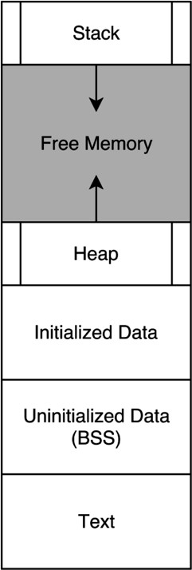
-Image source: https://en.wikipedia.org/wiki/Data_segment
-Representation of a program in memory
-What do you recognize?

Slide 57
Allocated as Program Runs
-Image source: https://en.wikipedia.org/wiki/Data_segment
-You’ve seen these two before
-What might the rest be?

Slide 58

Everything Below is Allocated at Program Load
Allocated as Program Runs
Constants (e.g., strings)
Mutable Global Variables
Code
-Image source: https://en.wikipedia.org/wiki/Data_segment

Slide 59
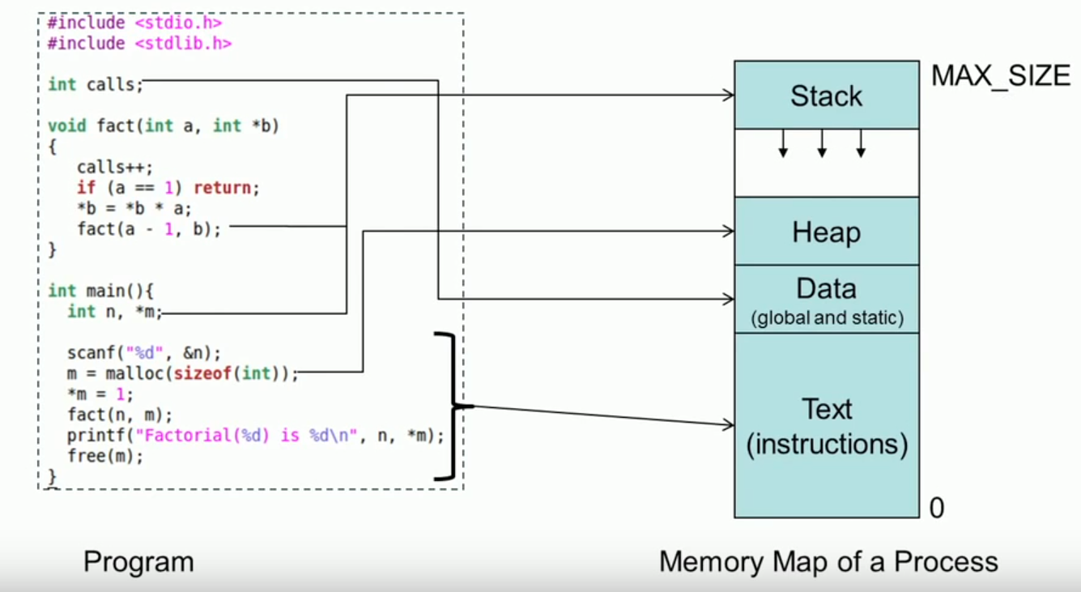
Process Memory Map

Slide 60
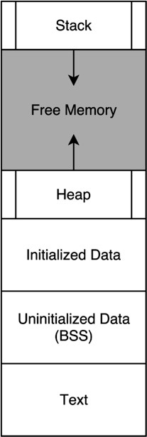
Marking Code
Use a .text directive to specify code section
.text
mov mov add mov | r0, r1, r2, r1, | #5 #7 r0, r1 r2
mov swi | r0, 0x6B | #1
swi | 0x11
-Directives tell the assembler to do something

Slide 61
Marking Code
Use a .data directive to specify data section
.data string1:
.asciz “hello” string2:
.asciz “bye”
-Directives tell the assembler to do something

Slide 62
ARMSim# Demo:
hello.s

Slide 63
ARMSim# Demo:
arithmetic_ops.s

Slide 64
ARMSim# Demo:
read_and_print_int.s

